Slide 1
Community RUGBY LEAGUE
Concussion Protocols
Notes:
In recent years, Concussion and Head Injury awareness and treatment has been extremely important to all Sports and particularly contact sports.
We need to continue to reinforce the importance of communicating these rules to ALL club members
The NSWRL has updated its Head Injury protocols for the 2026 season, which aligns with the NRL Community Guidelines in the best interests of all participants.

Slide 2
2026 Community Concussion Protocols
NSWRL Head Injury Assessment and Return to Play PROCEDURES
Attendance: Please complete attendance sheet include write name and club in the chat on this call.

Slide 3
2026 Community Concussion Protocols
NSWRL Head Injury Assessment and Return to Play PROCEDURES
Concussion - Management and Return to Play - Play Rugby League
Notes:
Please see a short video which provides an insight to what concussion is, and the importance of management.

Slide 4
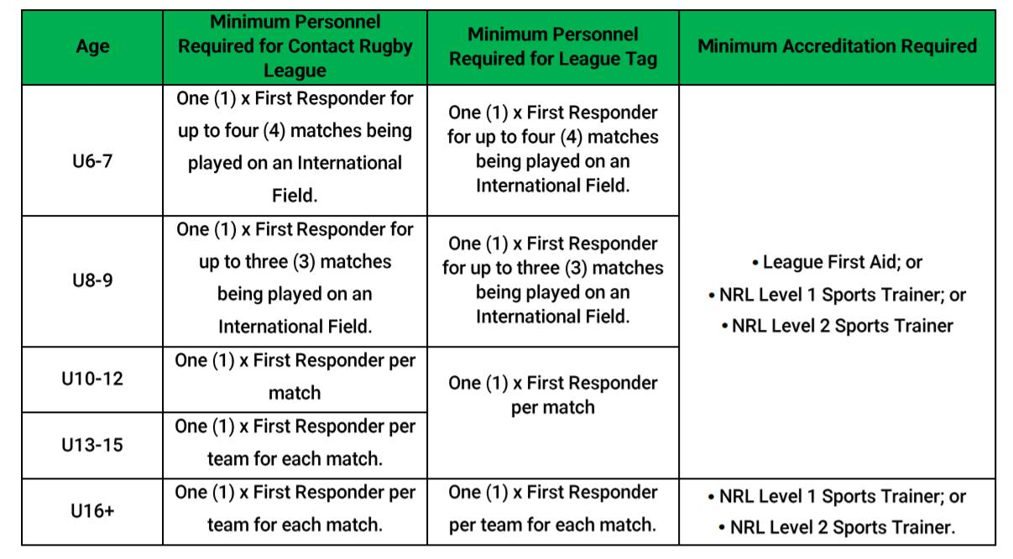
2026 Community Concussion Protocols
NSWRL Head Injury Assessment and Return to Play PROCEDURES
Ground Managers need to be aware of minimum requirements for First Responders under the NSWRL and NRL Community RL On Field Policy:
Notes:
Again, ground managers should be aware of the on-field policy for First Responders.
The On-Field Policy must always be followed, with no exceptions. If any teams/officials are not compliant, the match must NOT go ahead.

Slide 5
2026 Community Concussion Protocols
NSWRL Head Injury Assessment and Return to Play PROCEDURES
During Game - Sports Trainers
1. RECOGNISE THE INJURY
- Loss of consciousness or non-responsive
Lying on the ground – not moving or slow to stand
Clutching at head
- Unsteady on feet/balance problems/poor coordination
2. REMOVE THE PLAYER FROM THE ACTIVITY INCLUDING TRAINING, WARM-UP OR GAME
Initial management of a head injury or suspected concussion must always follow first aid rules, including airway, breathing, CPR and spinal immobilisation
A player who has suffered a suspected concussion or exhibits the symptoms of concussion should not return to play.
Assessor should not be swayed in opinion by the player, team staff or parents
Notes:
The following slide emphasises the role of the first responder sports trainer on game day. From recognising the injury to removing the player from the game. It is important to recognise the injury by observing the relevant signs.
Loss of consciousness
Lying on the ground – not moving or slow to stand
Clutching at the head
Unsteady on the feed/balance problems/poor coordination
Following the protocol when assessing a player for injury and removal from the game.

Slide 6
2026 Community Concussion Protocols
NSWRL Head Injury Assessment and Return to Play PROCEDURES
3. Complete the Head Injury, Recognition and Referral Form and refer to a doctor for assessment
All players removed from a game or training session with a suspected concussion must seek medical assessment by a doctor within 72 hours (3 days) of the injury even if the signs and symptoms resolve.
4. If the player required immediate medical treatment and ambulance should be called
IF IN DOUBT SIT THEM OUT
Notes:
An important change to note is that the direction is for players with a suspected concussion must seek medical assessment by a doctor within 72 hours (3 days) of the injury even if the signs and symptoms resolve.
Presenter to emphasise the importance of removing any players if in doubt. The players safety must always come first.
It’s just a game of footy..

Slide 7
2026 Community Concussion Protocols
NSWRL Head Injury Assessment and Return to Play PROCEDURES
During Game - Ground Managers
1. Free interchange for the player removed under HIA protocol (not to return)
2. Mark the HIA on the game sheet once the suspected head injury is confirmed by the Sports Trainer.
3. Provide assistance as required
GROUND MANAGERS SHOULD HAVE ADDRESS AND CONTACT DETAILS OF LOCAL HOSPITAL EMERGENCY DEPARTMENTS, LOCAL DOCTORS AND MEDICAL CENTRES AVAILABLE TO ASSESS INJURED PLAYERS
Notes:
Ground Managers are to follow the three steps when a suspected head injury has occurred
1. Free interchange for the player removed under HIA protocol (not to return)
2. Mark the HIA on the game sheet once the suspected head injury is confirmed by the Sports Trainer.
3. Provide assistance as required

Slide 8
2026 Community Concussion Protocols
NSWRL Head Injury Assessment and Return to Play PROCEDURES
  POST MATCH FOLLOW UP SPORTS TRAINER
  First Responder review regarding ongoing symptoms;
  Assign the Player to the care of a responsible adult;
  Give the care giver the completed Community Head Injury Recognition and Referral Form and advise the care giver to take the player directly to a Doctor or Hospital and monitor the Player until he or she has been assessed by a Doctor;
  Advise the carer of the warning signs and symptoms of deterioration;
  Advise the carer (and the participant) that the player must avoid alcohol and non-steroidal anti-inflammatory medication for at least 24 hours;
  Following a concussive episode, the Player should not be allowed to drive that day. Alternate transport needs to be arranged.
  THESE ARE ALL THINGS THE FIRST RESPONDER’S ARE TRAINED TO DO
Notes:
Presenter to run through the post match follow up steps by the sports trainer/first responder.

Slide 9
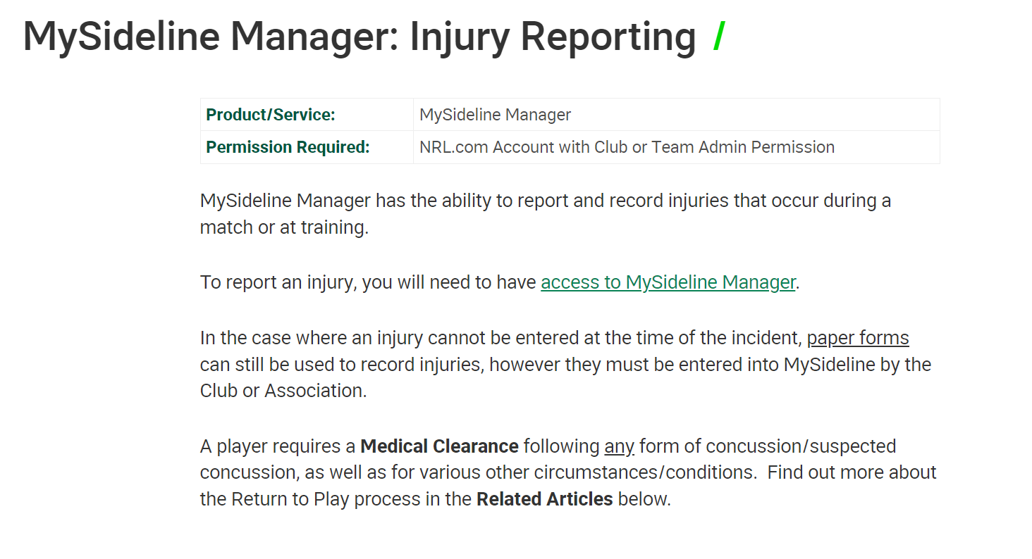
2026 Community Concussion Protocols
NSWRL Head Injury Assessment and Return to Play PROCEDURES
ONLINE REPORTING - MySideline Manager: Injury Reporting – Play Rugby League Support
Notes:
The reporting priority is to utilise the online injury reporting; recording all suspected concussions straight into MySideline.
We can’t emphasise enough that digital recording of injuries and suspected concussion through My Sideline is the priority
Online reporting is the most efficient process the make the player ‘unavailable’ in My Sideline and
The paper version is only a backup if someone doesn’t have an internet connection etc.

Slide 10
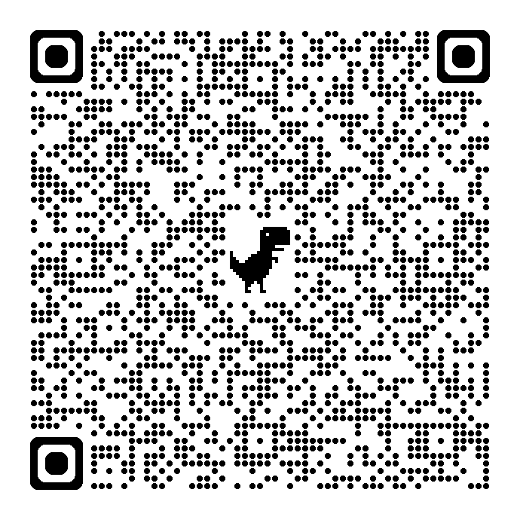
2026 Community Concussion Protocols
NSWRL Head Injury Assessment and Return to Play PROCEDURES
ONLINE REPORTING - MySideline Manager: Injury Reporting – Play Rugby League Support
Have your Sports Trainers been given Game Day admin access to My Sideline?
Remember to share the Online Reporting instructions with each Sports Trainer
Notes:
Key takeaways to communicate with Sports Trainers.
Scan this QR code for access to MySideline Injury reporting instructions.

Slide 11
2026 Community Concussion Protocols
NSWRL Head Injury Assessment and Return to Play PROCEDURES
The Guidelines for Management of Concussion in Rugby League are available at playrugbyleague.com
Any player deemed to have suffered a concussive injury will not be allowed to participate in any contact training until the end of Return to Sport strategy is completed successfully. A two-day contact training period MUST then be completed symptom free before returning to matches.
It is the club’s responsibility to ensure that the player takes the Community Head Injury Recognition and Referral Form to the doctor within 72 hours and the player/carer must return the form back to the club. After receiving the medical clearance, the player must return to contact training first and remain symptom free for 24 hours before they can return to the game.

Slide 12
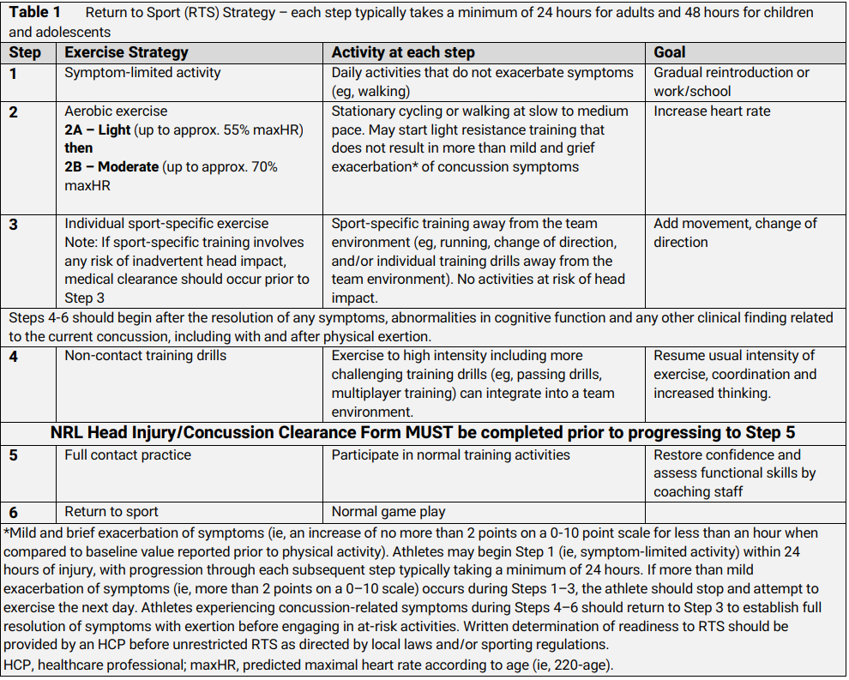
2026 Community Concussion Protocols
NSWRL Head Injury Assessment and Return to Play PROCEDURES
Return to Sport Strategy
Notes:
(straight from RTS Strategy)
Players should not attempt to return to play until they have returned to work or school/learning without resolution of their symptoms.
• Return to training or sport should be gradual.
• Rehabilitation after a concussion should be supervised by a medical practitioner and should follow the stepwise symptom limited progression as outlined in Table 1 below.
• Initially, relative rest for the first 24 to 48 hours – including mental and physical rest (recovery). Children and adolescents should be treated more conservatively, so a minimum initial 48 hour rest is recommended

Slide 13
2026 Community Concussion Protocols
NSWRL Head Injury Assessment and Return to Play PROCEDURES
Return to Play Protocols
First Concussion: Return to Play Protocols
Adults (19 years and older): If a concussion is confirmed by a doctor, the Return to Sport (RTS) program should be followed as per Community Head Injury Recognition and Referral Form .
Children and Adolescent’s (18 years old and younger): If a concussion is confirmed by a doctor, the Return to Sport (RTS) program should be followed as per Community Head Injury Recognition and Referral Form.
To proceed to contact training the player must have a completed NRL Community Head Injury/Concussion Medical Clearance form by a Doctor. If the medical clearance is not obtained the player cannot proceed to contact training stage or matches until received.
If the return to play protocols are complete and verified and the player is symptom free for the 24hrs post contact training, then the player can return and participate in a match (subject to forms being returned and approved by the Local League on a business day before the match) .
Notes:
Presenter to go through the return to play protocols.

Slide 14
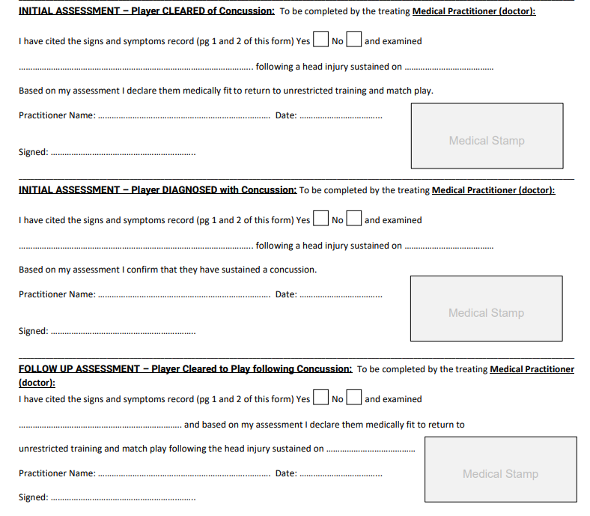
2026 Community Concussion Protocols
NSWRL Head Injury Assessment and Return to Play PROCEDURES
Medical Clearance Form
Doctor to assess and confirm if a concussion occurred after reviewing pages 1 and 2. If NO – sign and stamp section 1.
If yes, sign and stamp section 2.
If concussion diagnosed, the player is to return to the doctor for a follow up assessment post step 4 of the Return to Sport Strategy (minimum 14-16 days child/minimum 7-8 days adult)
(1)
(2)
(3)
Notes:
This section of the medical clearance form provides the sections the doctor is to complete.
If a doctor has deemed no concussion has occurred they are to sign and stamp section labelled one.
If a concussion has occurred the doctor is to sign and stamp section labelled two. The player is then to return to the doctor for a follow up assessment post step 4 of the Return to Sport Strategy. Once they’re cleared they can sign and stamp section labelled 3.

Slide 15
2026 Community Concussion Protocols
NSWRL Head Injury Assessment and Return to Play PROCEDURES
Reporting Process
All paperwork is to be sent through to your local league/NSWRL.
Players reported online will automatically be marked unavailable. NSWRL will mark any players unavailable who submit manually completed HIA paperwork.
Follow up clearances when received should be sent through at the earliest convenience. Note – the latest acceptance of a clearance will be 12pm Friday. Should the player be cleared, you will be advised by your NSWRL Club Competition Coordinator.
To proceed to contact training the player must have obtained a medical clearance from a Doctor via the Community Head Injury Recognition ad Referral Form. If a medical clearance is not obtained, the player cannot proceed to contact training stage or matches. Written confirmation is required from the NSWRL Club and Competition Coordinator before participation in contact training or matches is permitted.
IT IS EXTREMELY IMPORTANT CLUB CONCUSSION OFFICERS OR SECRETARIES ARE ACROSS ANY HIA REPORTED
Notes:
Presenter to run through the reporting process.

Slide 16
2026 Community Concussion Protocols
NSWRL Head Injury Assessment and Return to Play PROCEDURES
Concussion Officer
A recommendation from NSWRL is that all clubs have a Concussion Officer. The benefits of this role include:
Central point of contact for any players who may/have suffered a concussion. This assists both the player with the rehabilitation and ensures the club is across all documentation regarding the injury - ie. following up for clearances/following the Return to Sport Strategy.
Demonstrates the importance surrounding head injuries, and the extra level of care the club is going to.
Easier to follow up with players and parents.
Protects the clubs.
Notes:
A strong recommendation from NSWRL is that all clubs have a Concussion Officer at their club. The benefits include:
Central point of contact for any players who may/have suffered a concussion. This assists both the player with the rehabilitation and ensures the club is across all documentation regarding the injury
Demonstrates the importance surrounding head injuries, and the extra level of care the club is going to.
Easier to follow up with players and parents.
Protects the clubs.

Slide 17
2026 Community Concussion Protocols
NSWRL Head Injury Assessment and Return to Play PROCEDURES
Documentation – Community Head Injury and Referral Form
NRL Concussion Policy
Head Injury Recognition and Referral Form
Medical Clearance Form
Play Rugby League Concussion Page
EACH CLUB SHOULD HAVE AS MANY MEMBERS AS POSSIBLE COMPLETE THE ONLINE CONCUSSION MANAGEMENT ELEARNING MODULES TO ASSIST WITH EDUCACTION – COURSE LINK
Notes:
These are the links to some concussion resources which can be shared with clubs and leagues.

